Slide 1
Build a Better Project
Starting a DH Project from Primary Sources
Digi Colloquium
October 6, 2016

Slide 2
What to expect?
What you can do with a clean dataset
Introduction to statistical software JMP (“jump”)
Visualizations
Turning text to data
what is a primary source
how to set up a spreadsheet
data types
Back to JMP
Discussion
2
Notes:
Concatinating, text-to-column based on comma

Slide 3
JMP
Starts with a simple spreadsheet
simple interface (no coding!)
sophisticated statistical analyses
drag and drop visualizations
Availability
about $1000
UGA students and faculty get it for free!
just google “uga jmp” and you’ll find it
3

Slide 4
Where to Start?
4
Notes:
"Having the data is not enough. I have to show it in ways that people both enjoy and understand." -Hans Rosling

Slide 5
Primary sources
Depends on your field, project, question, etc.
recordings
newspapers, books, and other written material
censuses and other public documents
archeological records
observations
maps
images (digital or otherwise)
digital sources (web pages, online repositories, databases, etc.)
5

Slide 6
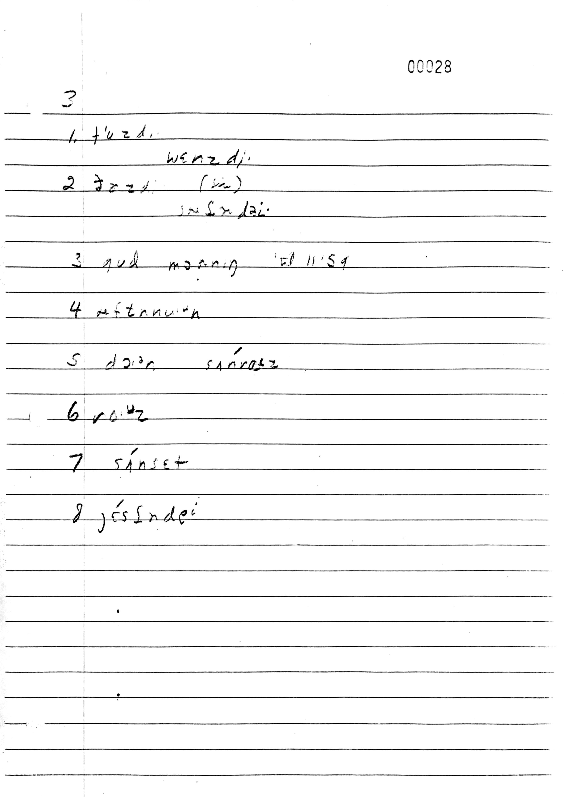
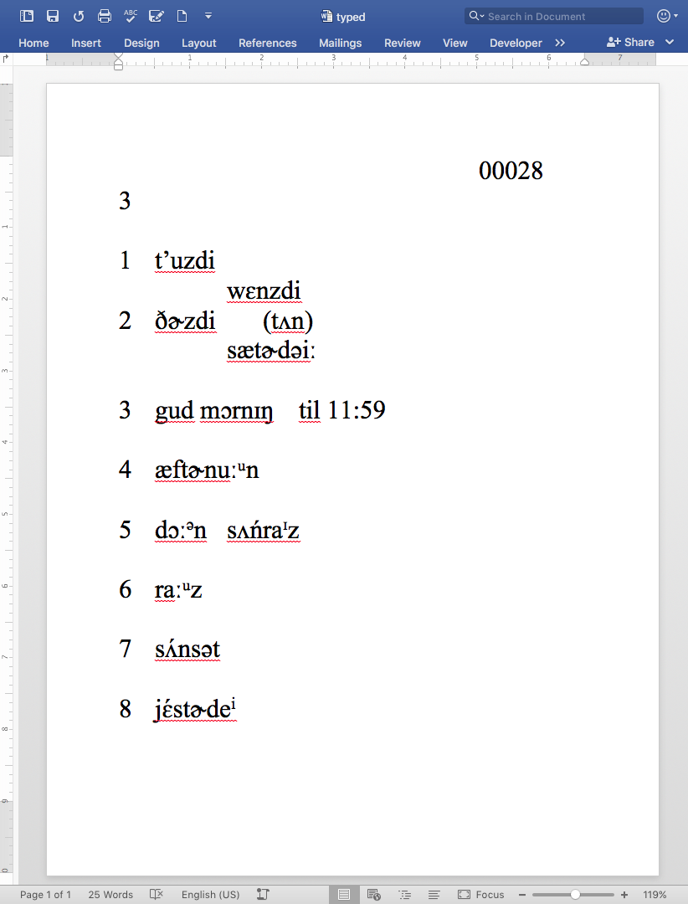
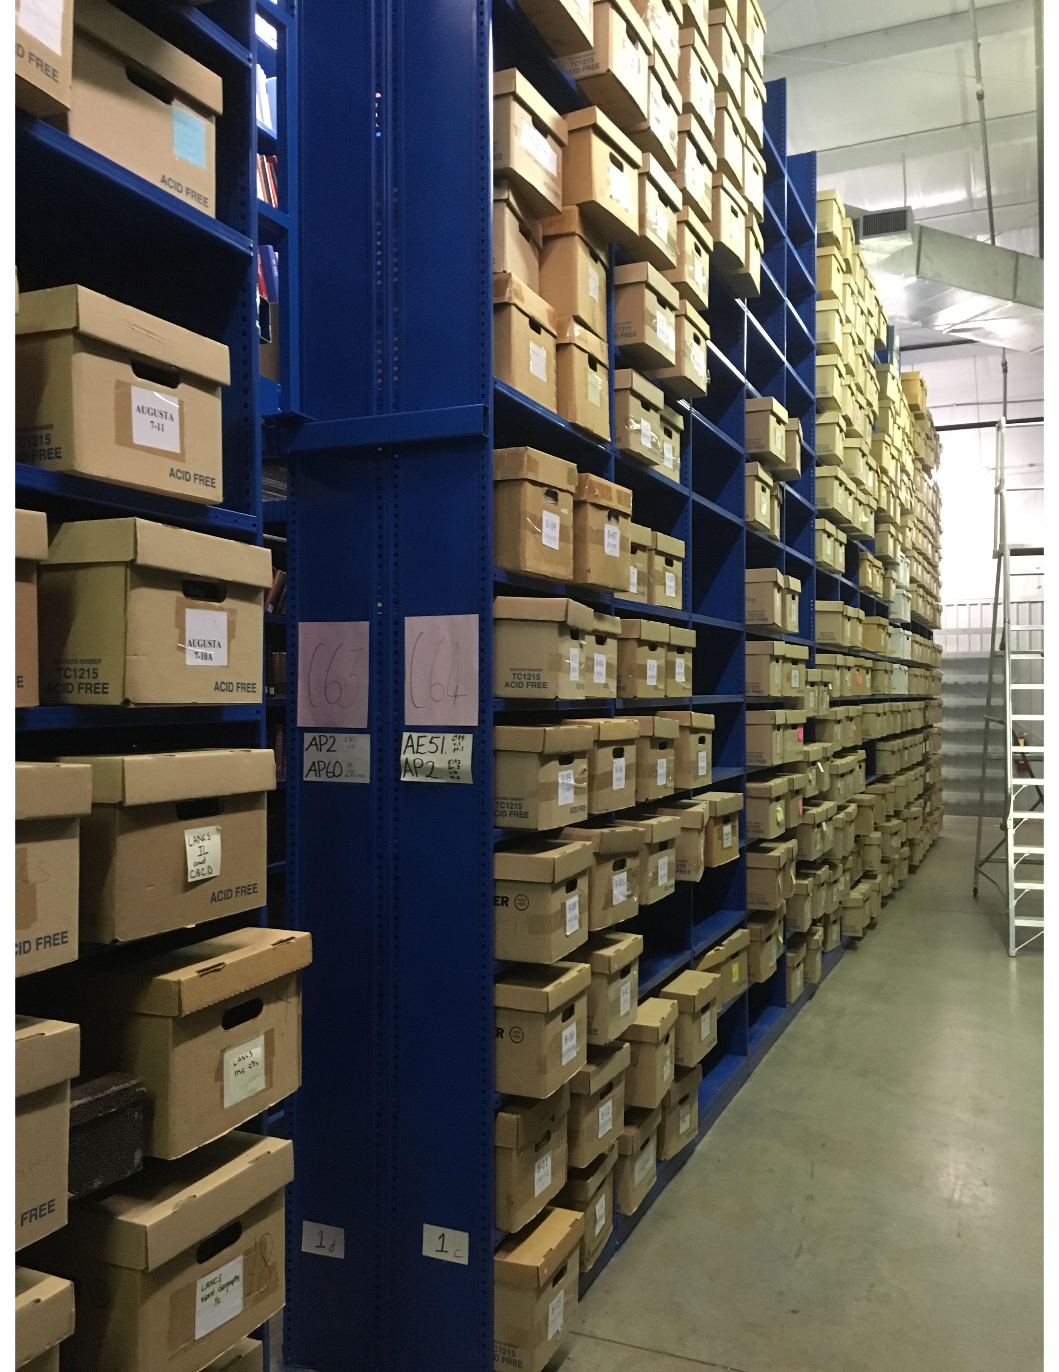
Digitizing
Linguistic Atlas Project (lap.uga.edu)
roughly 500,000 pages of handwritten notes
detailed phonetic transcriptions of hundreds of key words
Many have been scanned and digitized
hundreds of recorded interviews
Scanning isn’t enough
must make it searchable, useable
extract whatever you can out of it
Even typing it all up isn’t enough
there must be structure to the data
6
Notes:
So we’ve got this data? Great. What can we do with it? Nothing. It just sits in the repository collecting dust. The box that I’m interested in (PNW) hasn’t seen the light of day for a couple decades.
This stuff needs to be digitized. So, for the past few years, we’ve had undergrads scanning page after page, and you can see them on the website now.
But are we done? No. Scans are hardly any better than the originals.

Slide 7
Two ways of viewing the data
By person
View their one reponse to all questions
By question
View responses by all people
If only we could see both at the same time…
7
Notes:
All 4500 people answered the same questions. By nature of the interview process, the original field notes have information about a single person with multiple questions.
What if you want to organize the same information by the question, and see the differences in the responses?
This document took at least a year to prepare by the fielworker. He was dilligent and careful and I'm glad we have it. But it's not that useful.

Slide 8
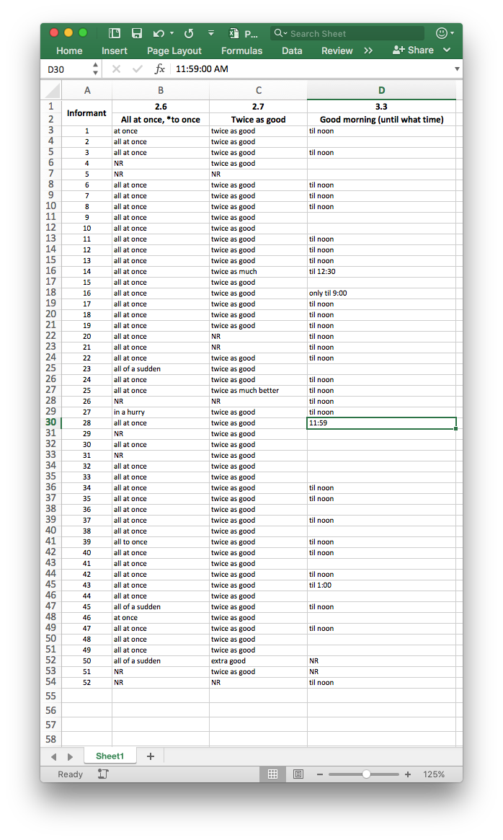
Spreadsheets (it’s okay, they don’t bite!)
8
Notes:
Filter based on responses from different questions
Information about people, like their demographic information, location (coordinates).
Consistency: "til noon", as opposed to "11:59"
Sorting, and some basic statistics, you can see if reponses correlate to information about this metadata

Slide 9
Spreadsheets (it’s okay, they don’t bite!)
View information by person and by question at the same time!
rows represent people
columns represent questions
But wait! There’s more!
sort
filter
add metadata about the people
consolodate and group responses for a question
find gaps
consistency
functions
counting, math, statistics
9
Notes:
Filter based on responses from different questions
Information about people, like their demographic information, location (coordinates).
Consistency: "til noon", as opposed to "11:59"
Sorting, and some basic statistics, you can see if reponses correlate to information about this metadata

Slide 10
Data Types

Slide 11
Data Types
Categorical
Quantitative
Not all data is created equal.
Why does it matter?
Visualizations
Statistical analyses
Various attempts to classify kinds of data
Here’s one version…
Binary
Ordinal
Continuous
Nominal
Discrete
More general
More specific

Slide 12
Categorical
Quantitative
arbitrary order
arbitrary labels
usually text, but can be numbers
no math
arbitrary difference between values
order is meaningful
measurements
only numbers are allowed
math is allowed
difference between the values is meaningful
12

Slide 13
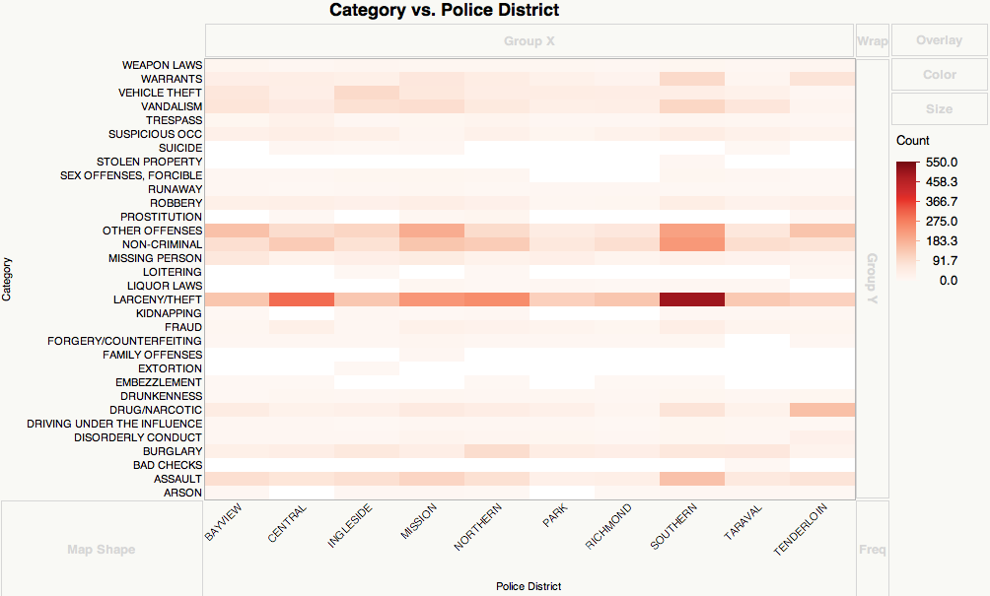
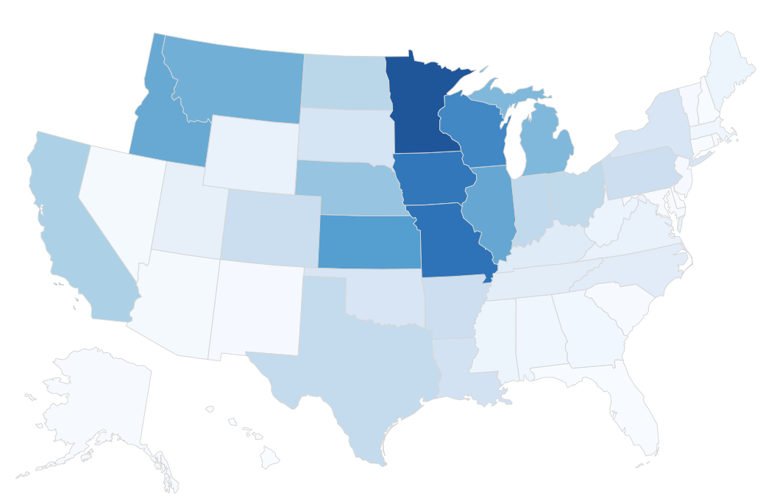
Categorical Data
Binary | Nominal | Ordinal
Examples true/false yes/no pass/fail Characteristics Only two possible values, usually polar opposites no order Statistical analyses logistic regression, mode, chi-squared, etc. | Examples favorite color state of birth student ID Characteristics 3 or more possible values order is meaningless Statistical analyses chi-squared test, ANOVA, mode, etc. | Examples agreement statements rankings Characteristics 2 or more values order has meaning, but arbitrary distance between Statistical analyses chi-squared test, ANOVA
13

Slide 14
Quantitative Data
Discrete | Continuous
Examples how many times times something happened how many people anything with counting Characteristics numeric data only usually no fractions, decimals Statistical analyses average, standard deviation, linear regression, correlation | Examples height, weight, size, speech latitude, longitutde Characteristics any number is permissible sometimes no duplicates are allowed Statistical analyses (pretty much) same as discrete
14

Slide 15
Binary
One of two options
Options are usually polar opposites, but not necessarily
Examples
Pass/fail, yes/no, true/false
Can still be meaningful:
Presence of cancer
Is located within 5 miles of a river
Is connected to some entity

Slide 16
Nominal
One of 3+ options
Order is arbitrary
Examples
Usually text/word-based:
favorite color
blood type
name of author
part of speech
state of birth
Can be numeric
ID number
number on a uniform

Slide 17
Ordinal
Has properties of categorical and continuous data
One of several options, but with a meaningful order
Difference between values is arbitrary
Examples
Answers to questionnaires
Rank
Notes:
Amazon ratings

Slide 18
Discrete/Count
Numeric data only, but only positive, whole numbers
no fractions, decimals, etc.
Some basic math allowed
Examples
anything with counting
number of times a word occurs in a text
number of transactions between two groups
number of times some event occurred

Slide 19
Continuous
Measurements generally
Any number is allowed
negatives and fractions are fine
With better instruments, a more precise value is possible
Theoretically, no two values are the same
Examples
Speed, height, size, distance, coordinates

Slide 20
Data types: summary
Categorical
Quantitative
Binary
Ordinal
Continuous
Nominal
Discrete
More general
More specific
15

Slide 21
Generalizing
Categorical
Quantitative
Given non-binary data, you can always go more general.
Example: height
continuous: micrometers
discrete: feet and inches
ordinal: short, average, tall
binary: short/tall
Binary
Ordinal
Continuous
Nominal
Discrete
More general
More specific
16
Notes:
Another example: height

Slide 22
Generalizing
Categorical
Quantitative
Information is lost
but there might be a good reason
It’s a one way street
It’s always better to start off as specific as possible!
…unless you want to recollect data
Binary
Ordinal
Continuous
Nominal
Discrete
More general
More specific
16
Notes:
Another example: height
You lose information with every jump you make.

Slide 23
A Brief Walkthrough
17

Slide 24
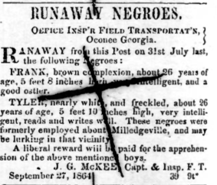
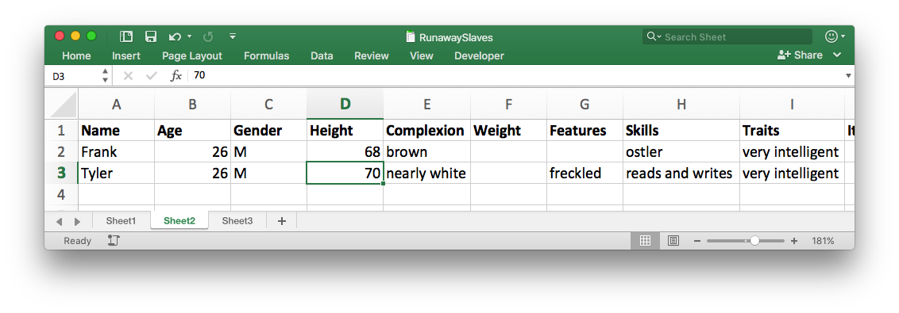
Runaway Slave Ads
Scott Nesbit, UGA Historic Preservation class, Spring 2016
What are the rows/observations?
one row per ad?
one row per person?
What are the columns/variables?
name
date
age
gender
escape location
ad location
description
etc.
18

Slide 25
Back over to JMP…
19

Slide 26
Summary
Gather information from primary sources
look for structure
what are the rows (observations)?
what are the columns (variables)?
Put this into a spreadsheet
this will take time…
Clean it up
consistency
check data types
Visualize
Draw conclusions
be the human—do what the computer can’t do
interpret the results appropriately
20

Slide 27
Conclusion
“Having the data is not enough. [You] have to show it in ways that people both enjoy and understand.”
–Hans Rosling
(the guy from that video we saw earlier)
21

Slide 28
Credits
Datasets
San Francisco Crime: sample dataset that comes with JMP
Census data: collected by Joey Stanley from familysearch.org
Countries’ GDP and health data (bubble plot): from gapminder.com
Vowels (3D-Scatterplot): Joey Stanley’s original data
Runaway slave ads: Scott Nesbit, Historic Preservation class, UGA Spring 2016
Images
Linguistic Atlas photos by Joey Stanley
Sample visualizations taken from Google image searches
22

